Slide 1
MSA Project
MEMS Based Biosensor
Group number - 6
Group members:
Donda Vishal - S20190020210
Kakarla V S S Pavan Teja - S20190020216
Kamarthi Litheesh Kumar - S20190020218
Kamalapuram Sreenivasulu Reddy - S20190020217
Course Instructor: Dr. Priyanka Dwivedi

Slide 2
Outline
Problem Statement
Working principle
Design
Simulation Results
Contributions

Slide 3
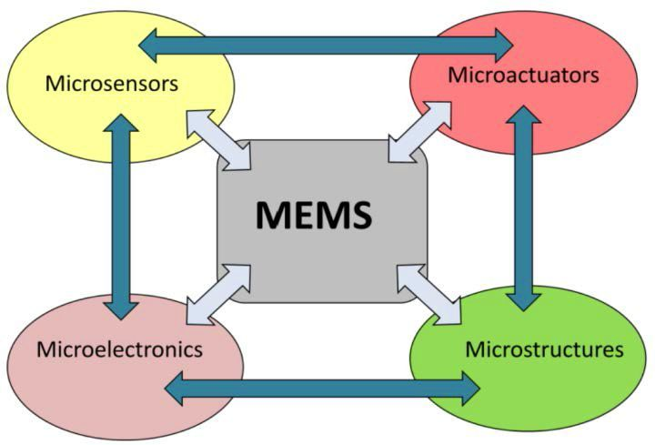
MEMS
MEMS - Microelectromechanical systems.

Slide 4
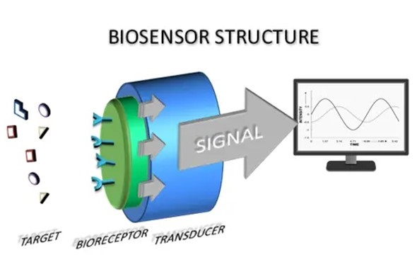
BioSensor
Measures biological or chemical reactions by generating signals proportional to the concentration of an analyte in the reaction.
Analyte, Bioreceptor, Transducer.
BioMEMS are miniaturized as biosensors.
Biosensors are employed in applications such as disease monitoring, drug discovery.
The output signal can be displayed in numeric, graph, tabular, or image format.

Slide 5
Problem Statement
The intention of this project is to realize a design of MEMS Biosensor for detection of Covid-19 Virus.

Slide 6
Why we are doing this
COVID-19 is a pandemic recently affecting the entire world, declared a pandemic by the WHO.
The most common COVID-19 diagnostic techniques for SARS-CoV-2 presently are RT-PCR and Immune Response Detection.
Since antibodies do not appear before the 7th day of infection, Immune Response Detection techniques entirely miss the patients in the early stages of infections.
Therefore, there is need of detection technique which can bridge the gap between existing diagnostic technologies.
Piezoelectric MEMS detection method for the virus, which is fast, portable, cost-effective, require less amount of sample, reliable, and can diagnose the stage for SARS-CoV-2 from the first day of virus infection.

Slide 7
Working Principle
Piezoelectric MEMS sensors are used as mass and viscosity sensors.
The pits of the cantilevers are functionalized by applying the bio-receptor, and then the analyte is deposited.
The bioreceptor and analyte form the bio-complex which is unique.
The principle involves bio-sensing, change in mechanical properties of the cantilever due to force/mass applied, and generation of electric energy via piezoelectric material.
The applied mass of the complex generates a force and the mechanical quantities of the cantilever like stress and displacement are changed proportionally to the force.
Change in stress generates a voltage across the electrodes(Aluminium layers) of piezoelectric material(PZT-5A).

Slide 8
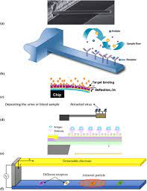
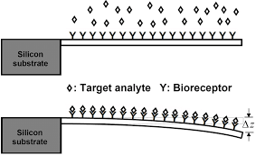

Slide 9
Design Methodology
Design comprises three cantilevers (viral load, IgM, and for IgG).
The cantilever beam has dimensions 450μm*90μm*5μm.
The first layer is the silicon cantilever with a pit at a free end.
At the fixed end, a piezoelectric material (PZT-5A) is placed with dimensions of 120μm*90μm*2μm.
The piezoelectric material is sandwiched between upper and lower aluminum layers; they act as electrodes for measuring voltage.
PZT-5A as the piezoelectric material is selected because of its ability of constant performance even in extreme temperatures and/or widely varying temperatures.

Slide 10
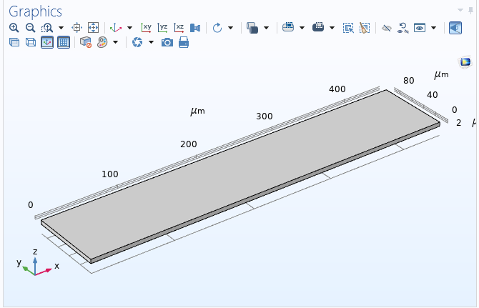
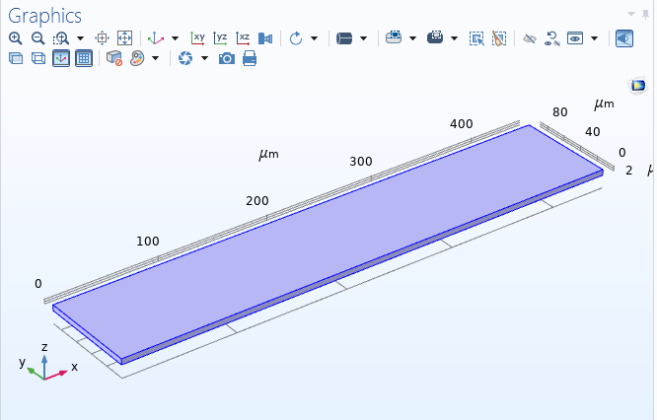
Design of Cantilever
Cantilever (450μm*90μm*5μm)
Cantilever material - Silicon

Slide 11

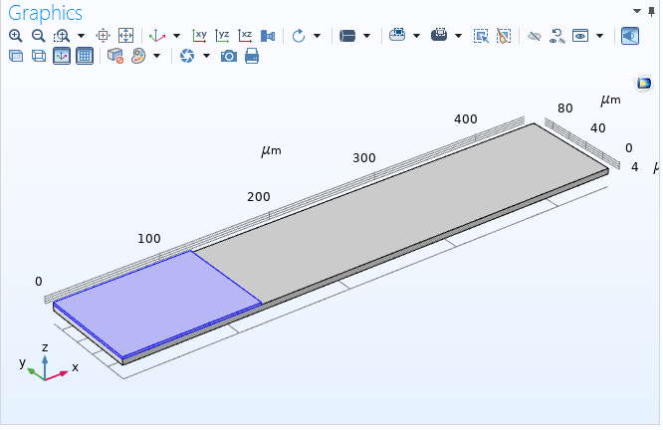
Design of Cantilever
Block (120μm*90μm*2μm) at fixed end
Block material - Aluminum

Slide 12
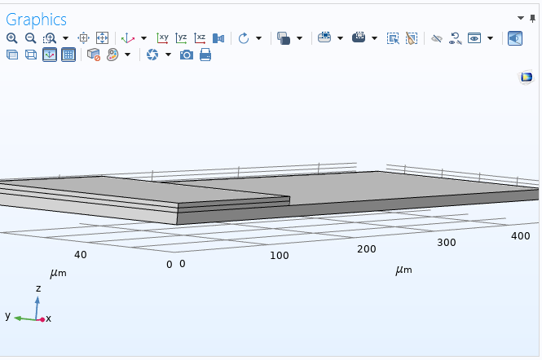
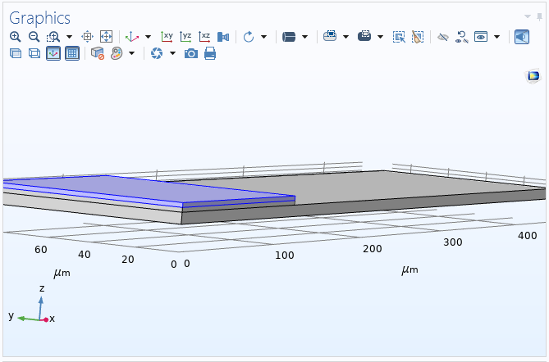
Design of Cantilever
Block (120μm*90μm*2μm)
Block material - PZT-5A

Slide 13

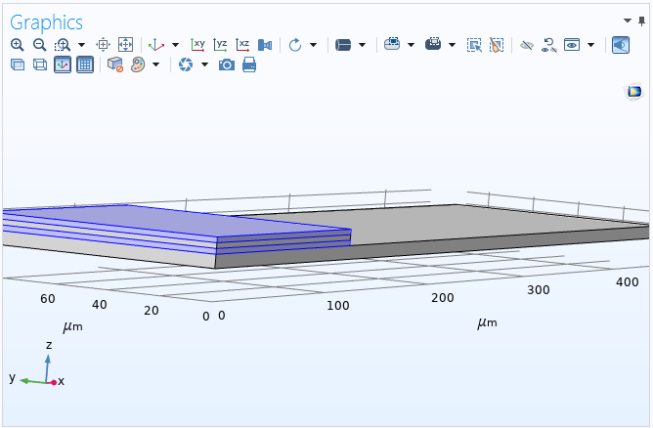
Design of Cantilever
Block size of 120μm*90μm*2μm
Block material - Aluminum

Slide 14
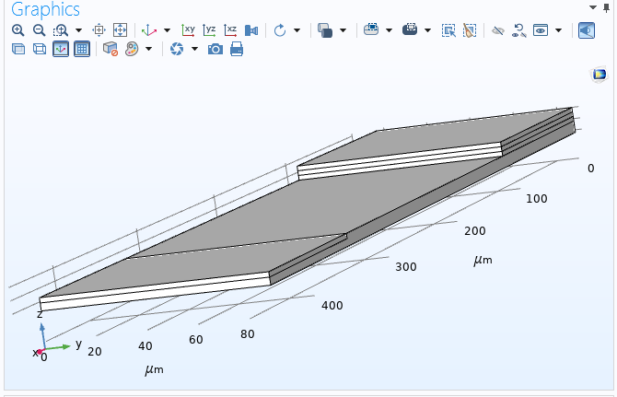
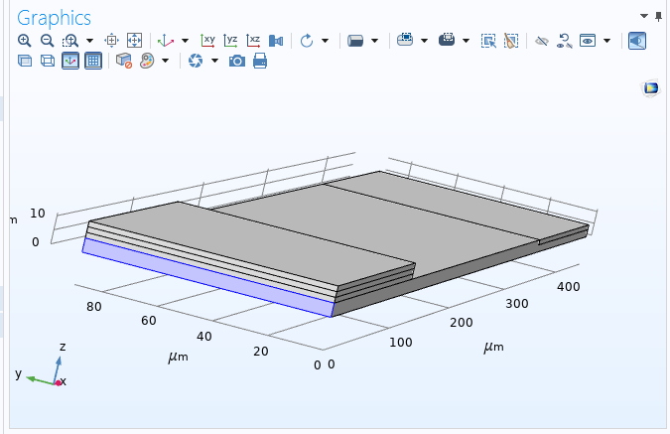
Design of Cantilever
Pit of size 100μm*90μm*2μm
Fixed Constraint

Slide 15
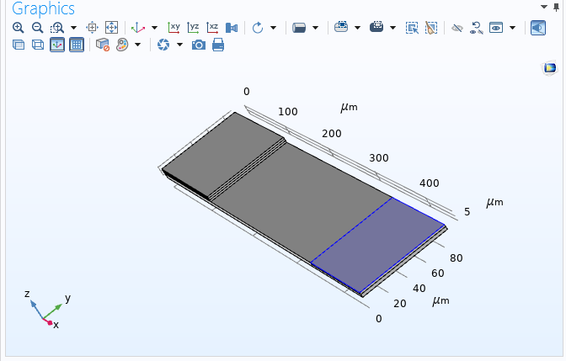
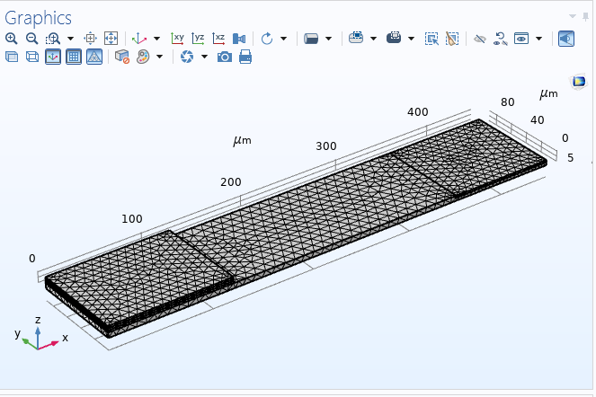
Design of Cantilever
Boundary Load of Pressure(10000 Pa)
Applied Mesh

Slide 16
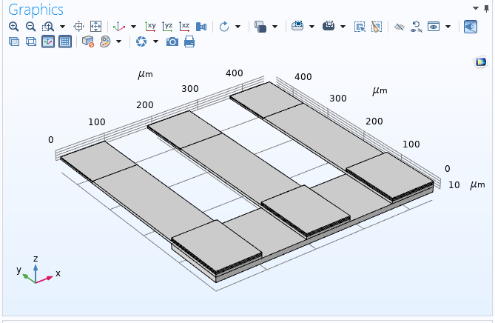
Design of Biosensor
Cantilever based Biosensor

Slide 17
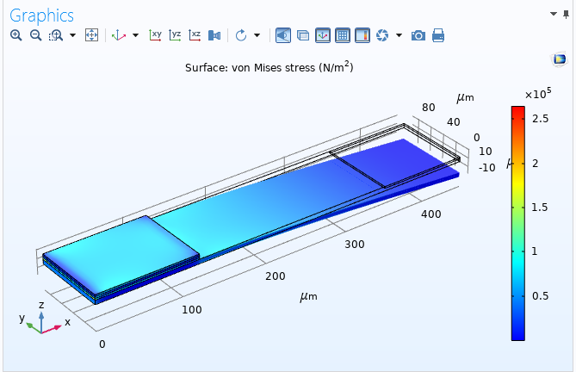
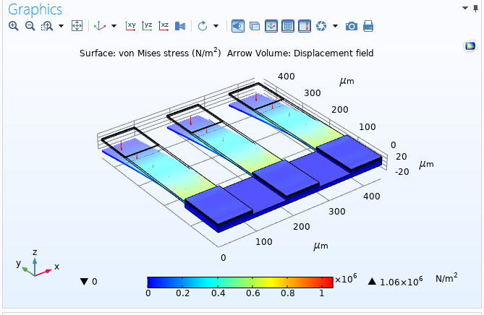
Results
Deformation of cantilever
Arrow Volume (displacement field)

Slide 18
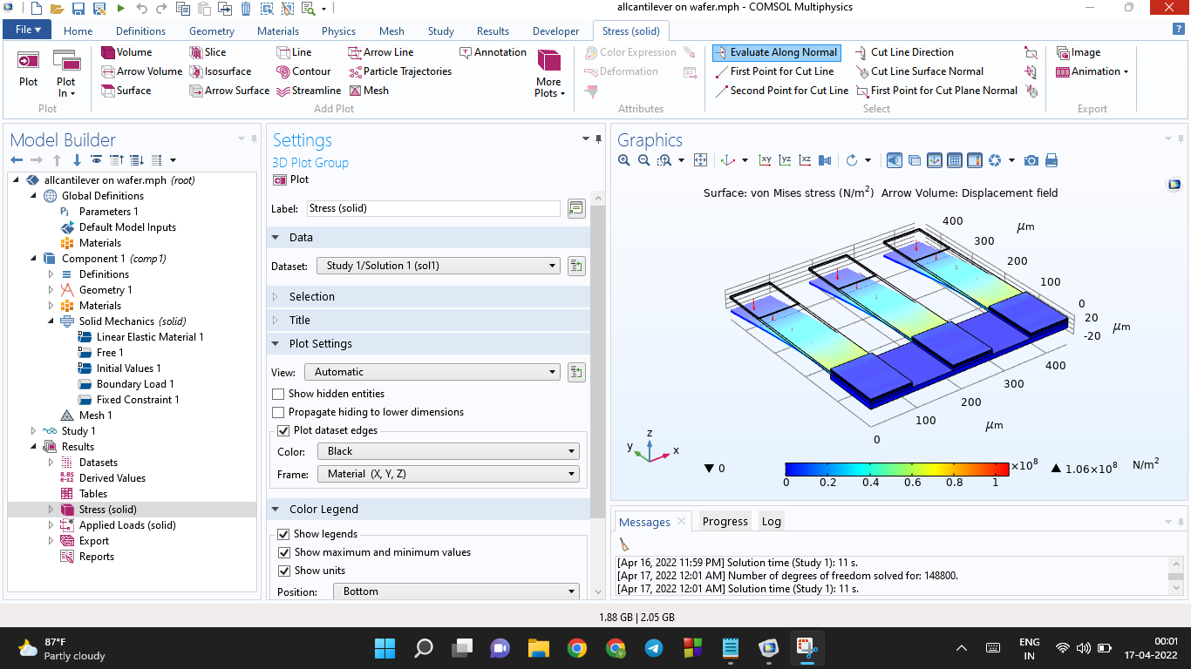
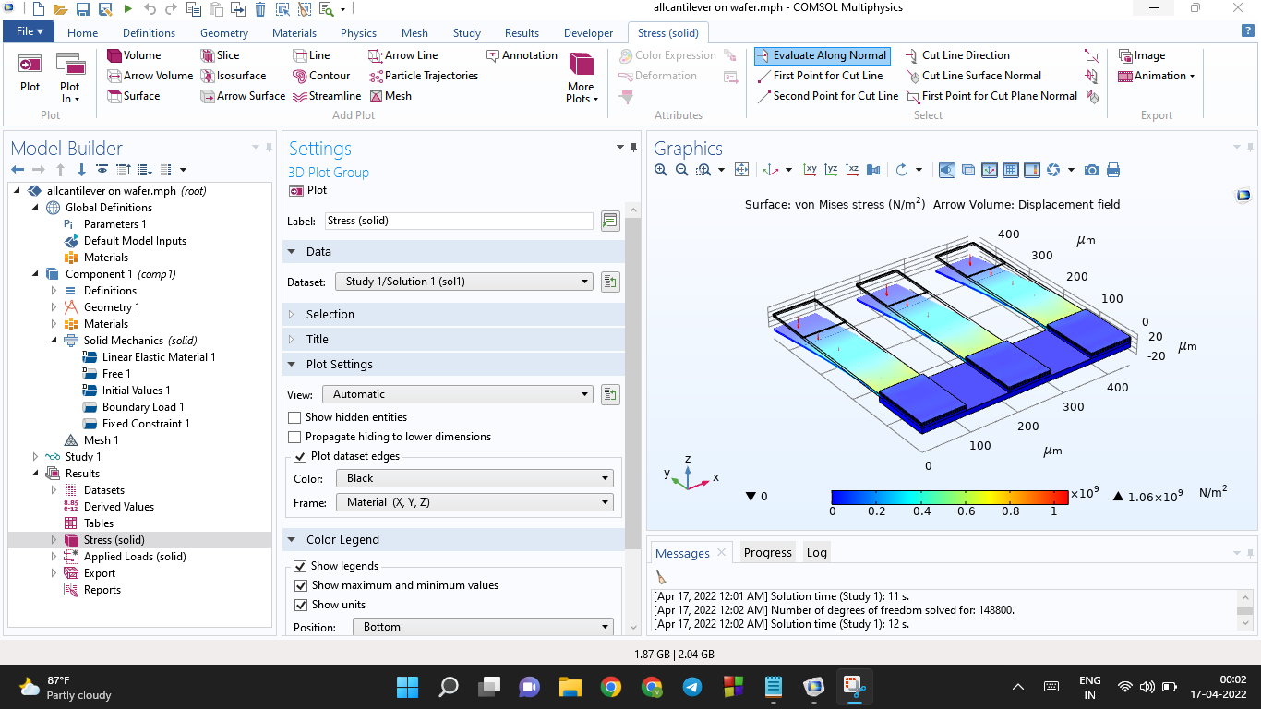
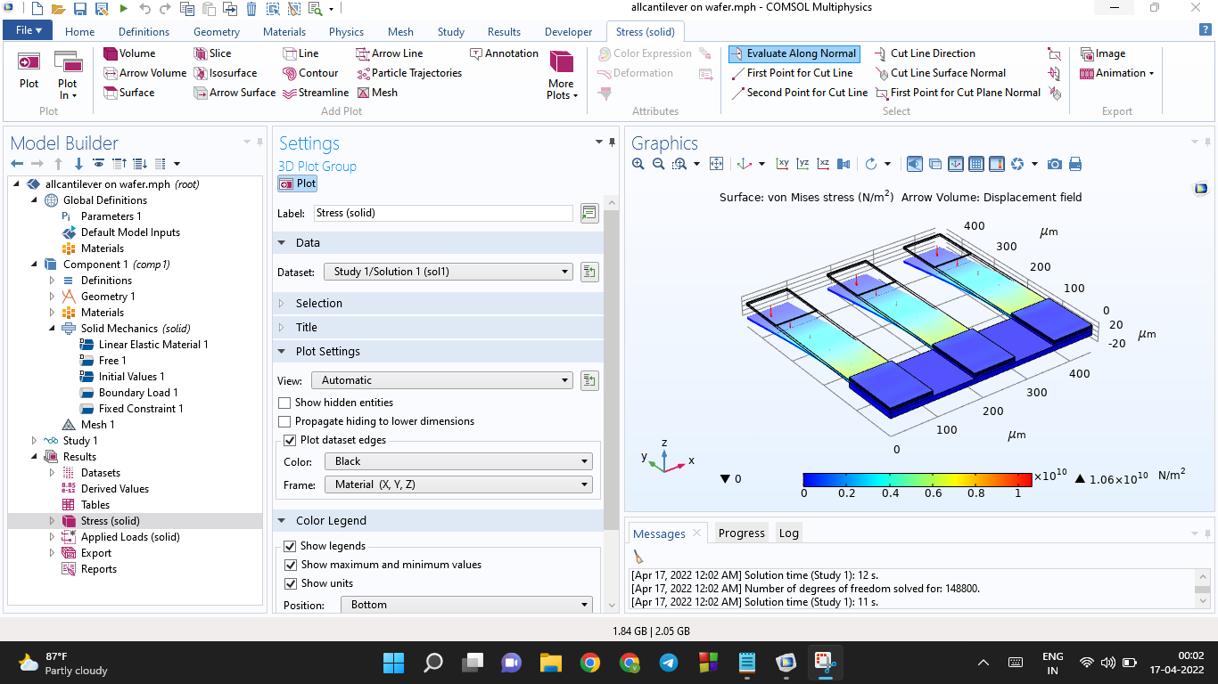
Results
P = 10K Pa
P = 100K Pa
P = 1000K Pa

Slide 19
Conclusion
Designed piezoelectric MEMS Cantilever based Biosensor detects Viral Load, IgM, and IgG values for SARS-CoV-2.
Its main advantage is that it can determine infection from the first day to months afterward, relative to RT-PCR, which provides positive results only till 25 days of illness.
The design gives results in 5 to 10 minutes, which is quicker than RT-PCR, and also has a reusability advantage.
The proposed sensor offers good mass sensitivity of almost 20 copies/ml.
Also, this is reliable, cost-effective, easy to use, portable, requires less amount of sample and may diagnose analytes in low concentration.
Some of the severe and critical cases can be handled within the first week of infection.

Slide 20
Contribution
K V S S Pavan Teja (S20190020216)– Cantilever for viral load (COMSOL).
K Litheesh Kumar (S20190020218) – Cantilever for IgM (COMSOL).
D Vishal (S20190020210) – Cantilever for IgG (COMSOL).
K Sreenivasulu Reddy (S20190020217) – Testing and Analysis, report,ppt.

Slide 21
References
M.G.G. Jithendra Prasad, Shameem Syed, “Design and analysis of micro-cantilever based biosensor for swine flu detection”, International Journal of Electrical and Computer Engineering, vol. 6, issue 3, June 2016, pp. 1190-1196.
Wan Y. Shih, Wei-Heng Shih, Zuyan Shen, “Piezoelectric cantilever sensors”, issued Dec. 2,2008, U.S. Patent 7,458,265 B2.
Arpana Niranjan, Pallavi Gupta, Manisha Rajoriya, “Piezoelectric MEMS Micro-Cantilever Biosensor for Detection of SARS–CoV2”, Sharda University, Greater Noida, India, IEEE 20 July 2021, DOI: 10.1109/ICCISc52257.2021.9484976.
https://www.coventor.com/blog/overview-piezoelectric-mems-principles-applications/
21

Slide 22
THANK YOU

